Slide 1
Insurance Recommendation Application using Google Generative AI
Tinnie – your AI Insurance Policy Assisntant

Slide 2
Objective
Create an application that chats with a user and then recommends the most suitable insurance policy based on the attributes of the users.

Slide 3
Requirements
Introduce itself to the user and ask the user if he/she is happy to answer some questions to determine the suitable insurance policy for him/her.
Questions shouldn’t be hardcoded.
Cannot ask questions like “what insurance product do you want?”
The 3 insurance products are; Mechanical Breakdown Insurance (MBI), Comprehensive Car Insurance and Third-Party Car Insurance.
There are two business rules: - MBI is not available to trucks and racing cars. - Comprehensive Car Insurance is only available to any motor vehicles less than 10 years old
Ask relevant questions from the user to determine the best insurance product for him/her.
Recommend one of more insurance products based on the answers of the user.

Slide 4
Basic Web Application Design
Front-end
SvelteKit
Back-end
NodeJs with Express
Generative AI
Google Gemini Generative AI (Streaming chat)
Front-end back-end connection
- WebSockets (To use the advantage of Generative AI streaming chat)

Slide 5
Front-end
SvelteKit (static page)
Typescript
TailwindCSS
Socket.io-client package
Svelte-markdown package

Slide 6
Back-end
NodeJs with Express
Google Gemini Generative API
Socket.io package

Slide 7
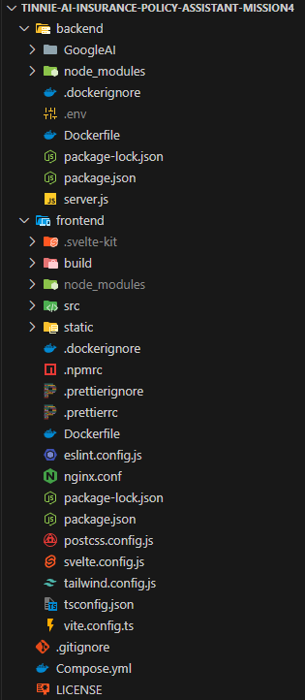
Folder Structure

Slide 8
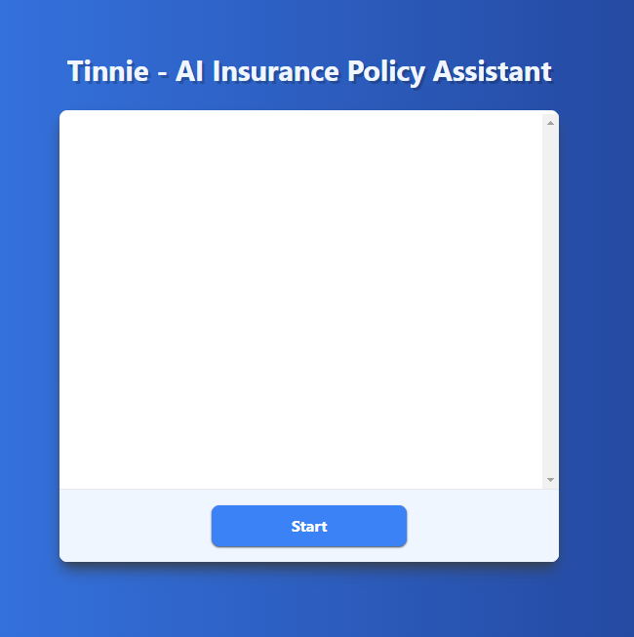
Interface

Slide 9
Docker
Dockerfile in both front-end and back-end.
Compose.yaml for running the whole project.

